Slide 1

The principles of
animation
Tutor : Liyan Chen
Email: chenliyan@xmu.edu.cn

Slide 2
Chapter 8
Scenes Design

Slide 3

The scene is equivalent to the stage in the animation, the scene design is the sub-shot script after the process.
According to the shooting script to determine the need for the scene, make a list of scenes, to the scene designer to draw the scene. In order to make the animated character active in the background, the animator should simulate the effect of the camera movement on the background. The animator can master the angle of view and narration of the animation completely by the background factors.
Once all the materials are finished, the original artist will create the stage animation.

Slide 4
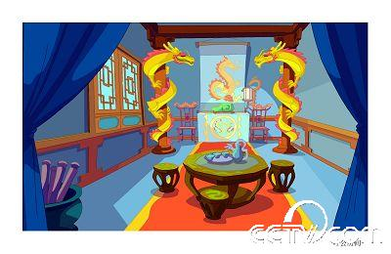
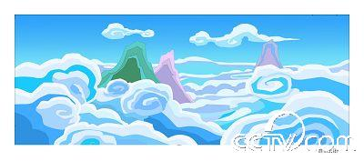
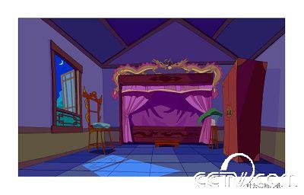
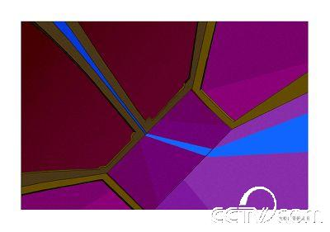
Mountains and clouds
Duke of Ye’s room
Interior view of Duke of Ye’s Room
The wardrobe overlooks the interior
Scene of “Lord Ye loves dragon”

Slide 5
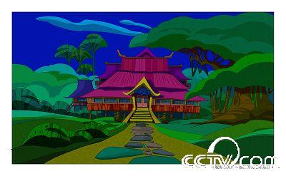
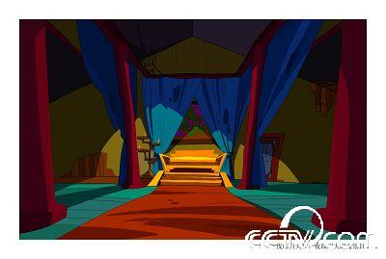
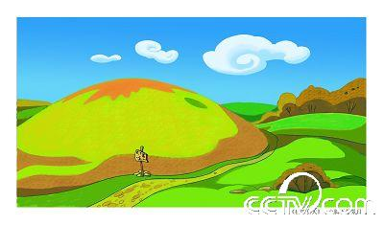
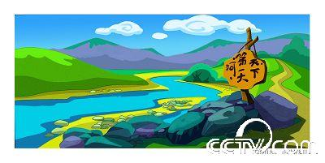
Yelang Hall, exterior
Interior view of Yelang Hall
Exterior shot at the foot of the mountain
River scene
Yelang

Slide 6
. Layering the scene
When drawing a scene in flash, we should also pay attention to drawing the foreground, middle background and background in layers. Although they are all part of the scene, they need to be made separately.
Layering scenes can be used as follows:
1. In a fixed lens, use it when the character passes behind the foreground and middle scenes, or to create the effect of selecting focal length.
2. In a moving camera, the foreground, middle, and background move together, but at different speeds. It creates a sense of depth.

Slide 7
The phenomenon of perspective
The term “Perspective”means the observation of natural objects through a perspective plane (such as a glass window) perpendicular to the ground.
When we stand in a fixed position and look in one direction, we see that objects of the same size will be imaged in different states and sizes on the retina of our eyes, depending on the distance and the position. This phenomenon is called perspective.

Slide 8
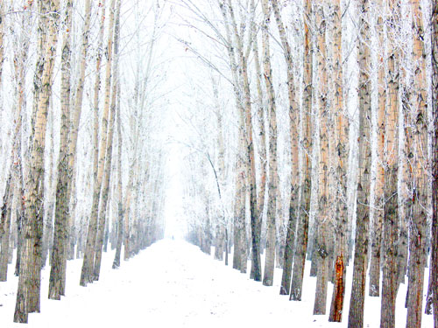

Slide 9
The main terms commonly used in clairvoyance
(1) point of view: the position of the painter’s eyes
(2) line of sight: a horizontal line at the front of the painter, equal in height to the point of view and parallel to the ground. In the vast sea, the horizon and the horizon of the flat grassland will coincide. When looking up, the eye level is low, and when looking down, the eye level is high.
(3) center point: the vertical point of view on the screen is called the center point. The intersection of vanishing line and line of sight in parallel perspective.

Slide 10
(4) point of remainder: the point at which the line of vanishing edge of an object intersects the line of sight in perspective. If the angular state is 45 degrees, then the vanishing line and the line of sight intersection point is called the distance point.
(5) the point of intersection of the vanishing line of an inclined edge above the median line perpendicular to the horizon in oblique perspective. The point of intersection must be above the horizon line.
(6) location: in oblique perspective, the point at which the vanishing line of the inclined edge intersects below the median line perpendicular to the horizon. The location must be below the horizon line.

Slide 11
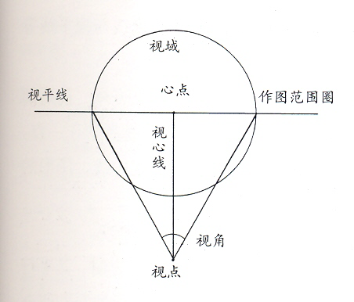

Slide 12
. The law of perspective
1. Parallel Perspective: as long as a square object has a set of planes that are parallel to the painter, the object appears as a parallel perspective, with the vanishing line of our vertical edges intersecting the line of sight at the center point. Parallel perspective has only one vanishing point.

Slide 13
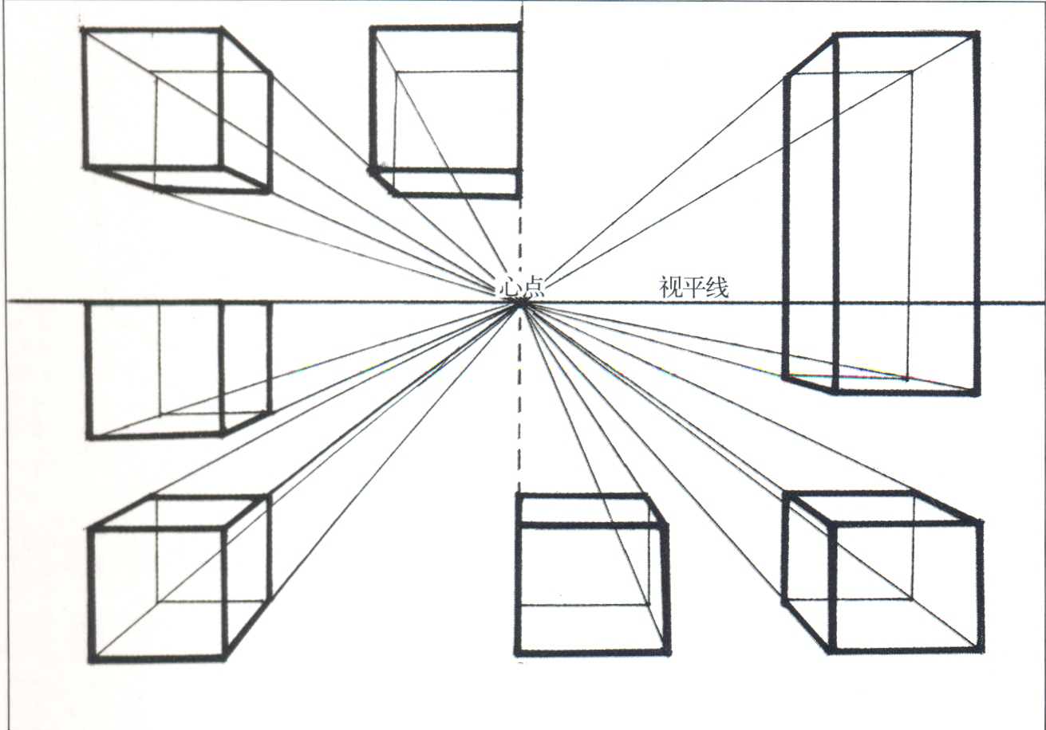

Slide 14
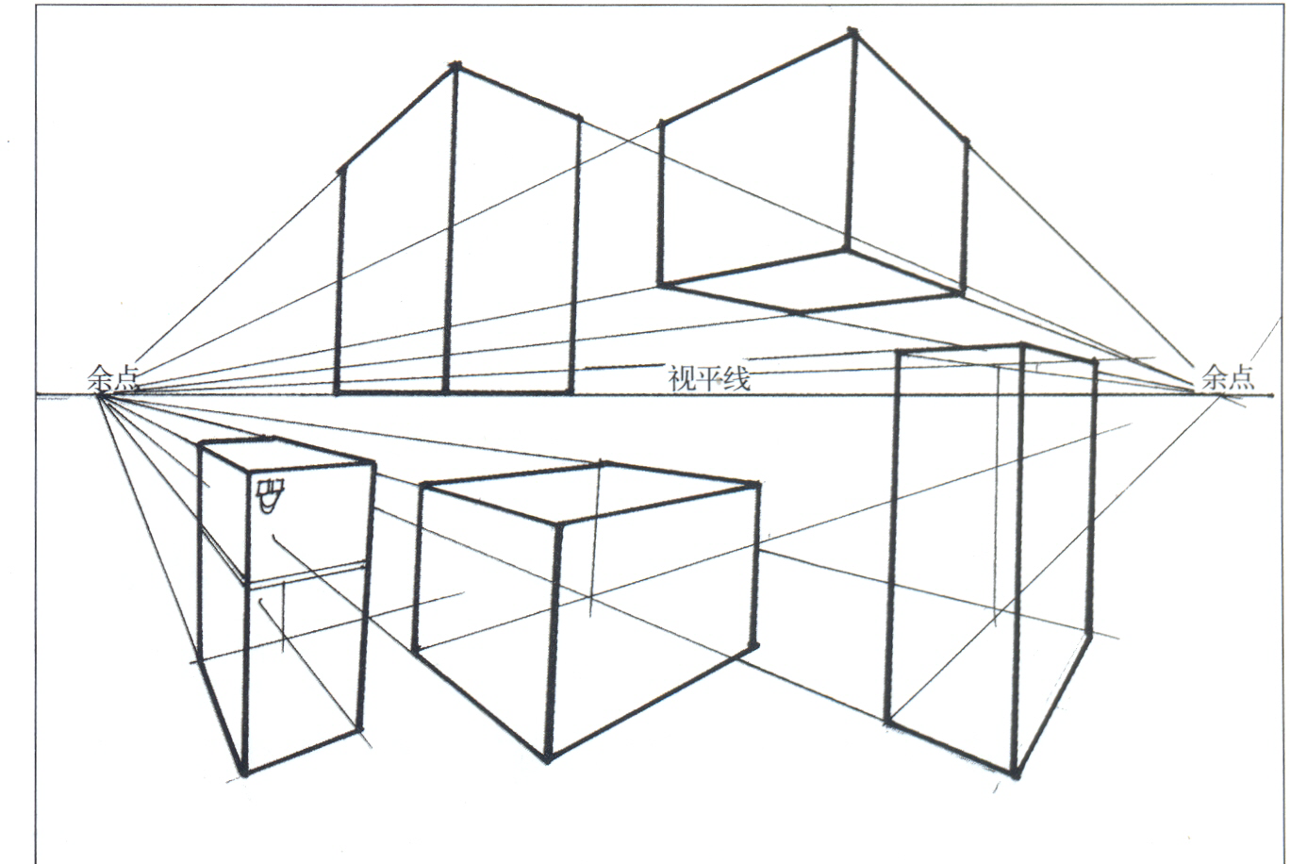
2. Angular perspective: as long as a square object has a set of planes that are angled to the painter, it will appear angular perspective. The vanishing line of the edges and corners on the left and right sides intersects with the line of sight respectively at the remainder point.

Slide 15
3. Oblique perspective: the object surface which is inclined to the ground is inclined perspective, and the vanishing point of oblique perspective is located at the sky point or the place respectively because of the different inclined direction.

Slide 16
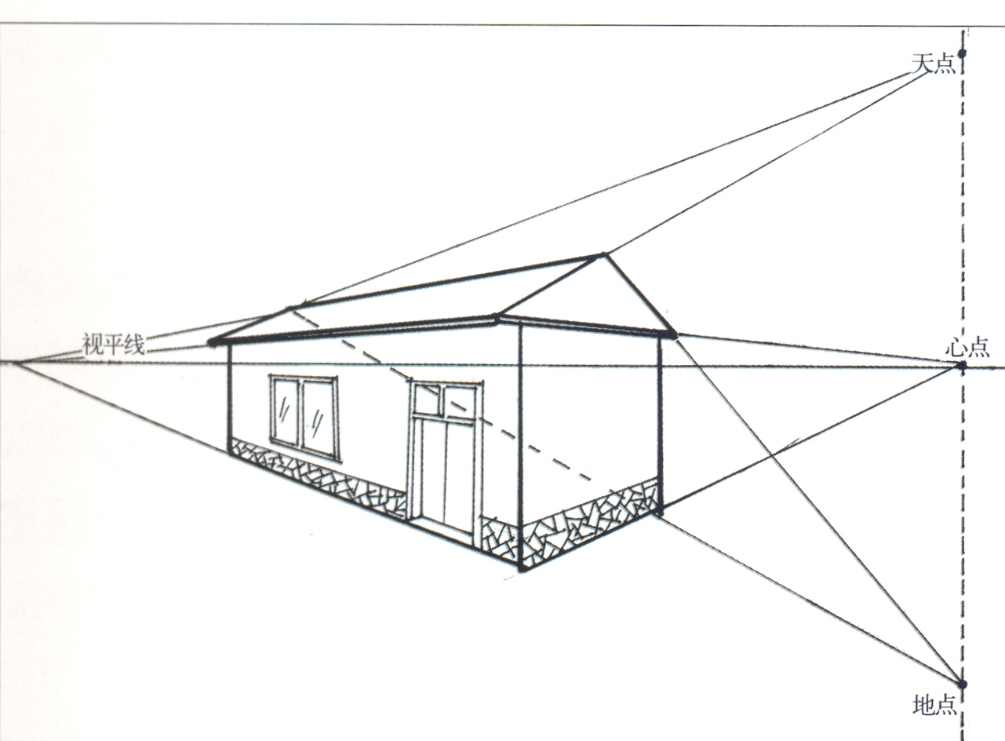

Slide 17
4. Circular perspective: different states of circles produce different states of perspective change law.
A circle in the same vertical position, the closer it is to the horizon, the flatter it is (eg, the two circles at the bottom and the mouth of a glass) .
B, in the same horizontal position but distance, the closer to the line of sight, the more flat circle, the smaller the shape (such as on the table on several disc) .

Slide 18
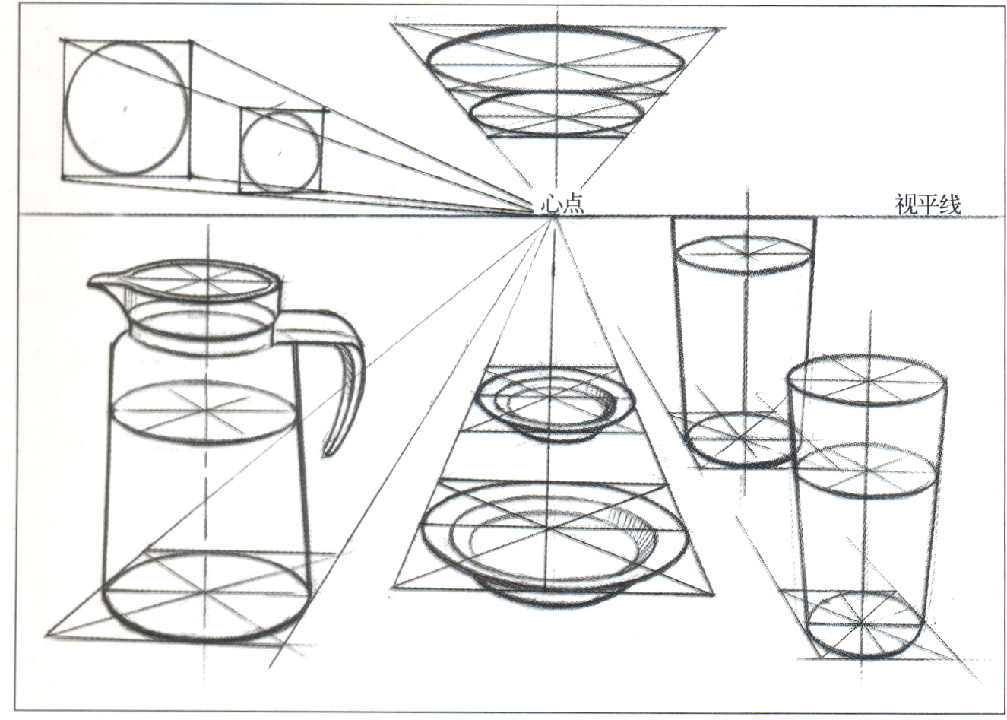

Slide 19
C. a circle perpendicular to the ground at an angle to the frame (except 90 degrees) is flat and larger near the centerline and smaller on the far side.
D. a circle perpendicular to the ground and parallel to the frame, with only the circle varying in size.

Slide 20
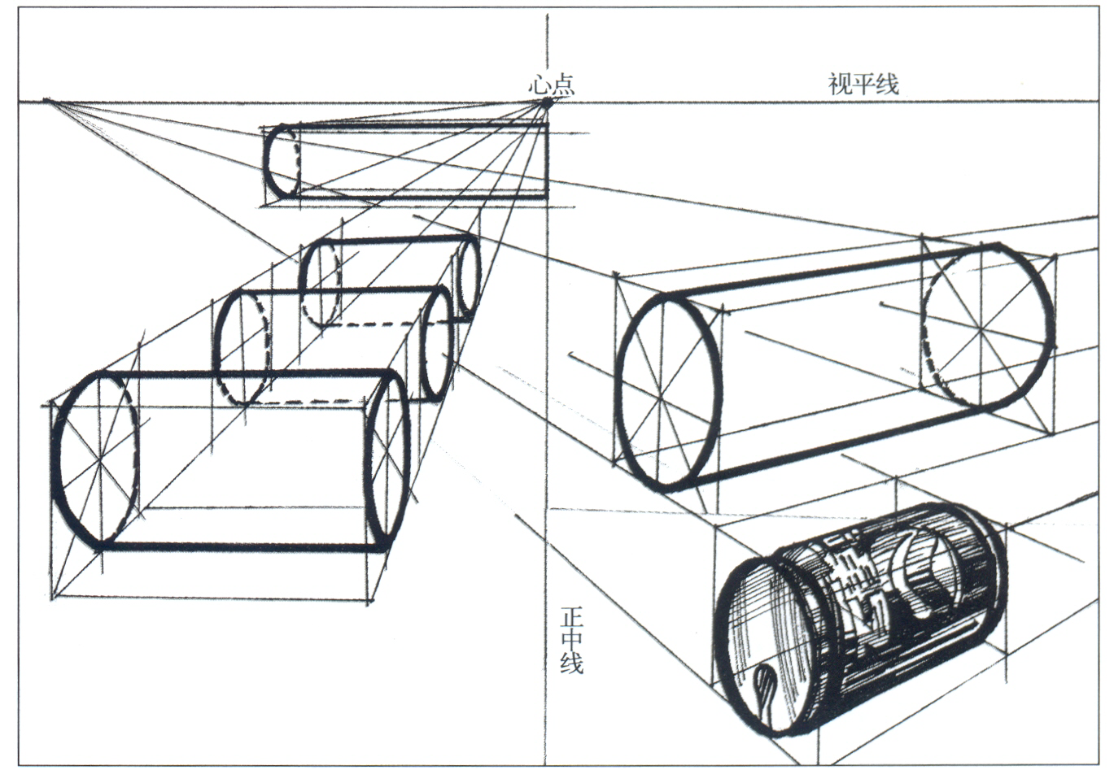

Slide 21
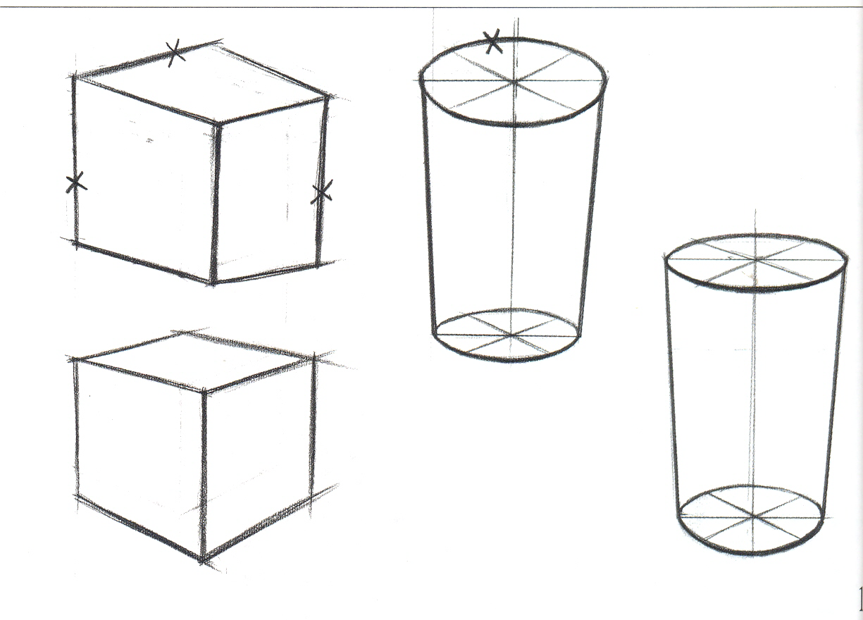
Common mistakes in perspective
(1) the far edge of the cube shall be shorter than the near edge, and the Oval at the mouth of the cup shall be flatter than the bottom.

Slide 22
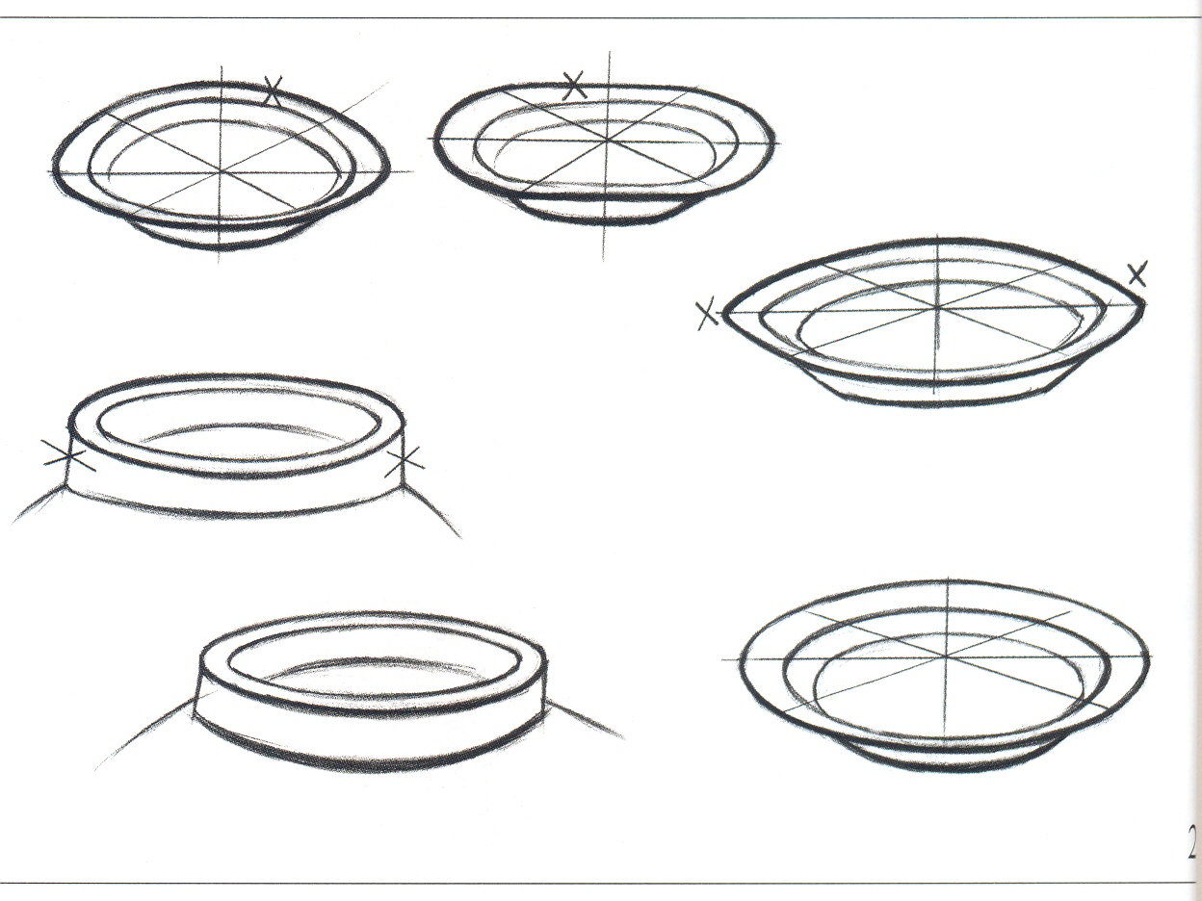
(2) the two ends of the mouth of the disk can not be drawn into a sharp shape, the middle part of the arc of the disk can not be drawn into a straight line, the back side of the arc of the disk is drawn too large, the left and right sides of the mouth of the tank should be shorter than those near it.

Slide 23
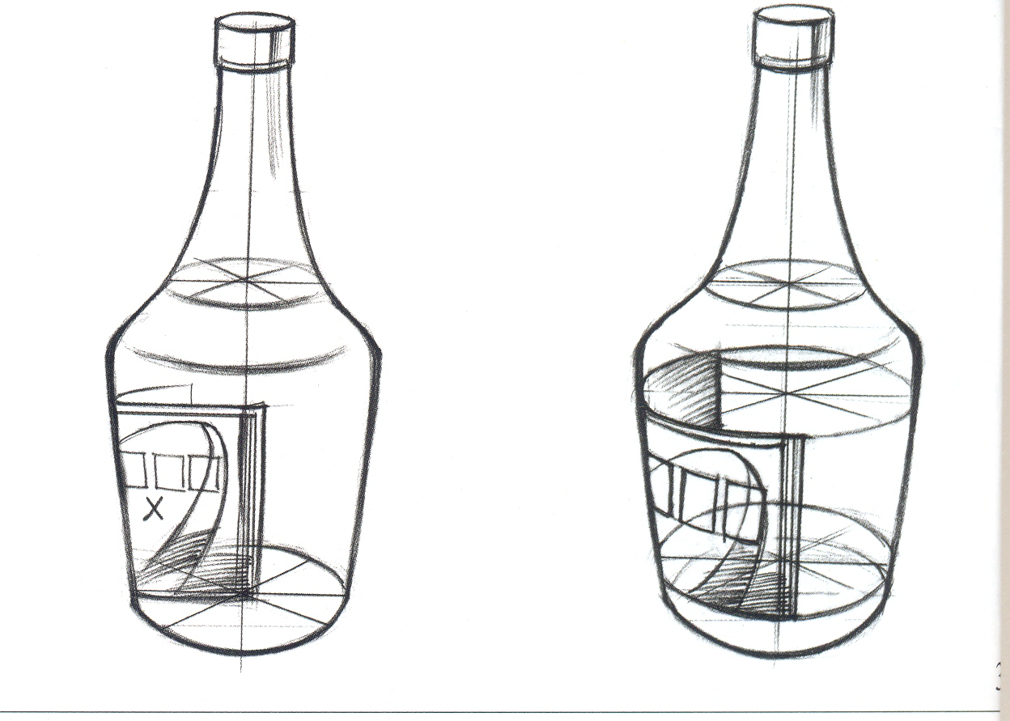
(3) the label shape of the wine bottle should be consistent with the cylindrical shape of the wine bottle.

Slide 24
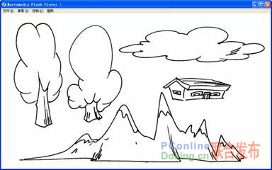
2. How to draw various background elements
In An, the cartoon story can be plotted in the air, the ground, the water, the universe and other environments, the natural environment of various objects become the elements of the background.

Slide 25
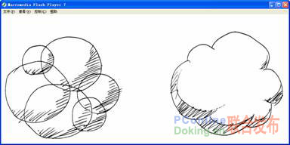
1. Smoke
Smoke can be seen as a combination of many spheres

Slide 26
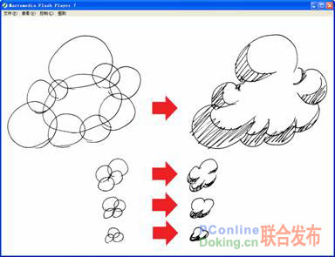
A number of spheres of varying sizes are grouped together to mark out the light and dark parts of the sphere, creating the smoke.

Slide 27
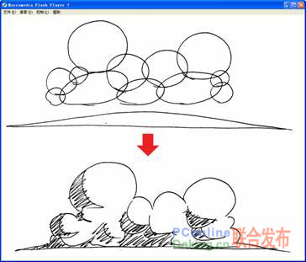
2. Clouds
Clouds are drawn like smoke, with spheres assembled and a long, flat geometry placed at the bottom, as shown in figure 5-1-47.

Slide 28
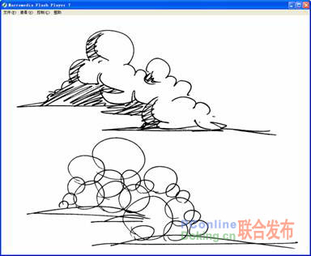
By dividing the light and dark sides of the sphere and the strip at the bottom, the clouds are drawn.

Slide 29
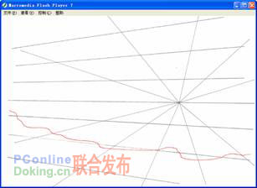
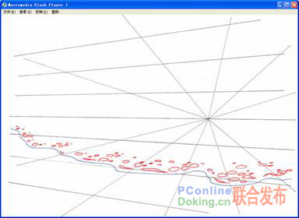
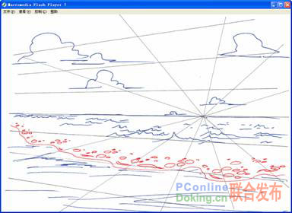
3. water
Draw a curve in perspective on the ground, in one side of the curve, according to the relationship between far and near size, draw a close to the ground oval, formed the water surface effect.

Slide 30
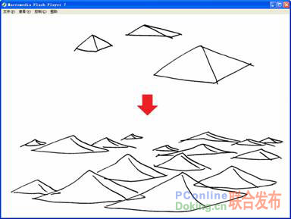
4. Waves
The way the waves are drawn can be seen in the distant mountains. Waves can be thought of as a group of geometries with broad ends and pointed tips. A wave group is formed when a number of geometries are stacked together according to the relationship between near, great, far and small.

Slide 31
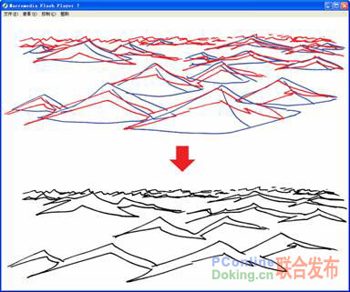
Finally, the light and dark parts of the wave group are divided.

Slide 32
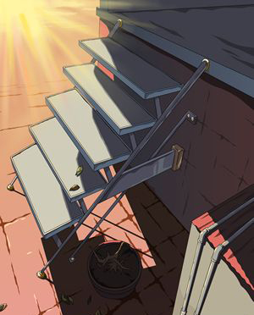
3. Flash rendering process

Slide 33
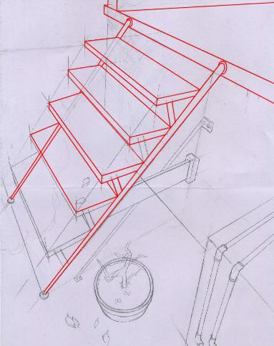
1. typesetting

Slide 34
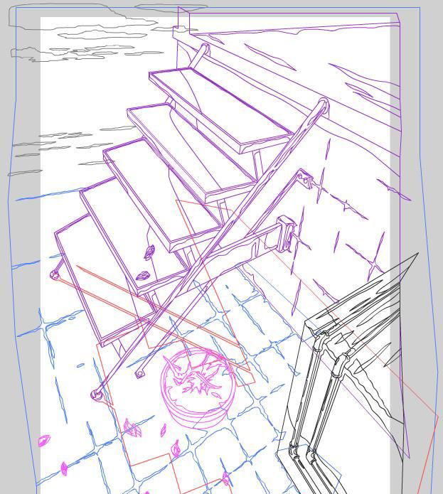
2. Layering

Slide 35
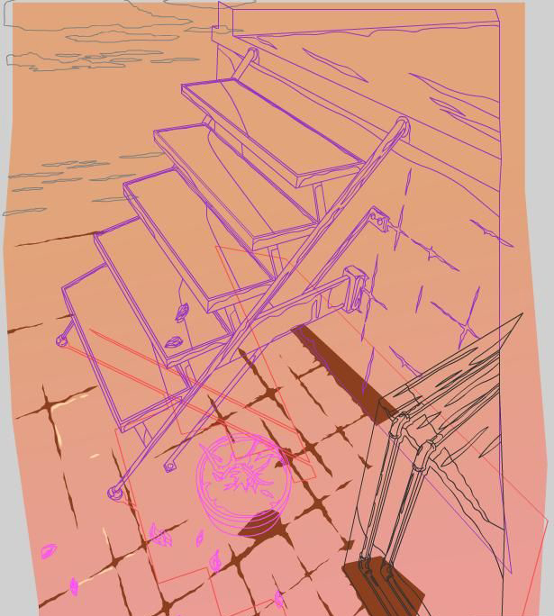
3. Undercolor

Slide 36
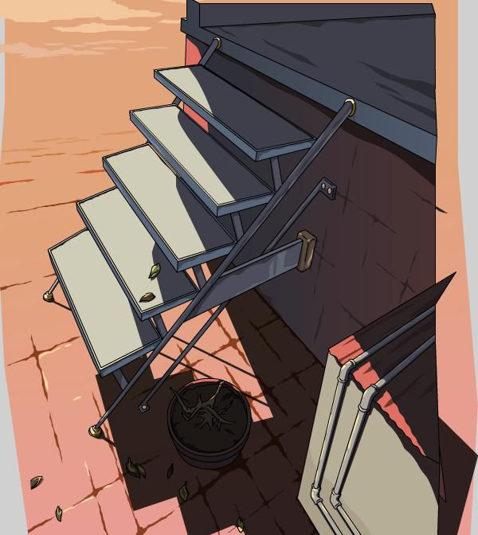
4. Paint

Slide 37
5. Do post processing in Photoshop

